Slide 1
Particle Swarm optimization for CH selection

Slide 2
Introduction
Particle swarm optimization (PSO) is a nature inspired swarm intelligence based algorithm, modelled after observing the choreography of a flock of birds, i.e., how they can explore and exploit the multi-dimensional search space for food and shelter.
PSO is a robust stochastic optimization technique based on the movement and intelligence of swarms
PSO consists of a predefined number of particles called a swarm. Each particle provides a potential solution.
The PSO ultimately reduces the cost of locating optimal position for the cluster head nodes.
The PSO implementation is performed within the cluster.

Slide 3
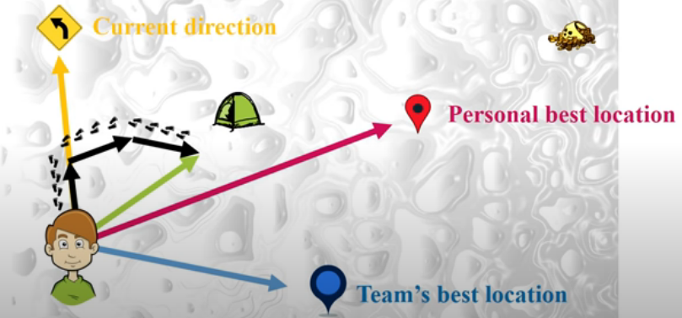
PSO Search strategy
During the iteration, each particle updates its position according to its previous experience and the experience of its neighbor.
A fitness function is used to evaluate each particle for verifying the quality of the solution. The objective of PSO is to find the particle’s positions that result best evaluation of the given fitness function.
During each iteration (generation), each particle finds its own best, i.e., personal best called Pbest i and also the global best called Gbest.

Slide 4
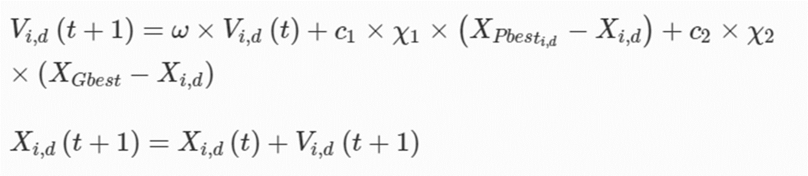
Algorithm
A particle P i , has position X i,d and velocity V i,d
To reach the global best solution, it uses its personal and global best to update the velocity V i,d and position X i,d using the following equations.
Current direction -Inertia
Personal best location –Cognitive component
Team’s best location – Social component

Slide 5
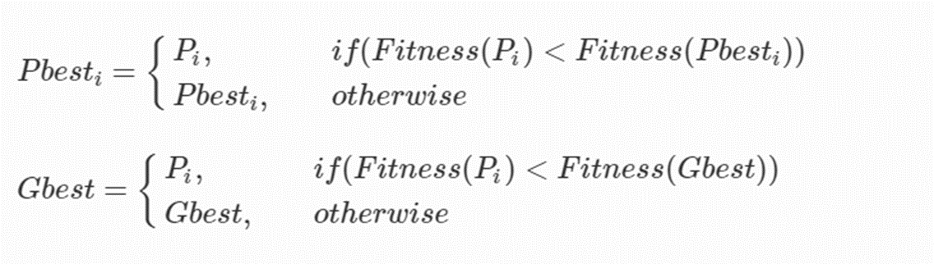
ω, 0 < ω < 1 is the inertia weight, c 1, c 2, 0 ≤ c 1, c 2 ≤ 2 are the acceleration coefficients and χ 1, χ 2, 0 < χ 1, χ 2 < 1 are the randomly generated values.
The updating process is repeated until it is reached to an acceptable value of Gbest. After getting new updated position, the particle evaluates the fitness function and updates Pbest as well as Gbest for the minimization problem as follows

Slide 6



Fitness function
One of the objectives for optimal selection is to minimize average intra-cluster and sink distance of all the CHs.
Another objective is to maximize the total current energy of all the selected CHs, i.e., we need to minimize its reciprocal.
PSO objective is to minimize the linear combination of both the above two objective functions instead of separately minimize them. Other parameters also can be added.

Slide 7
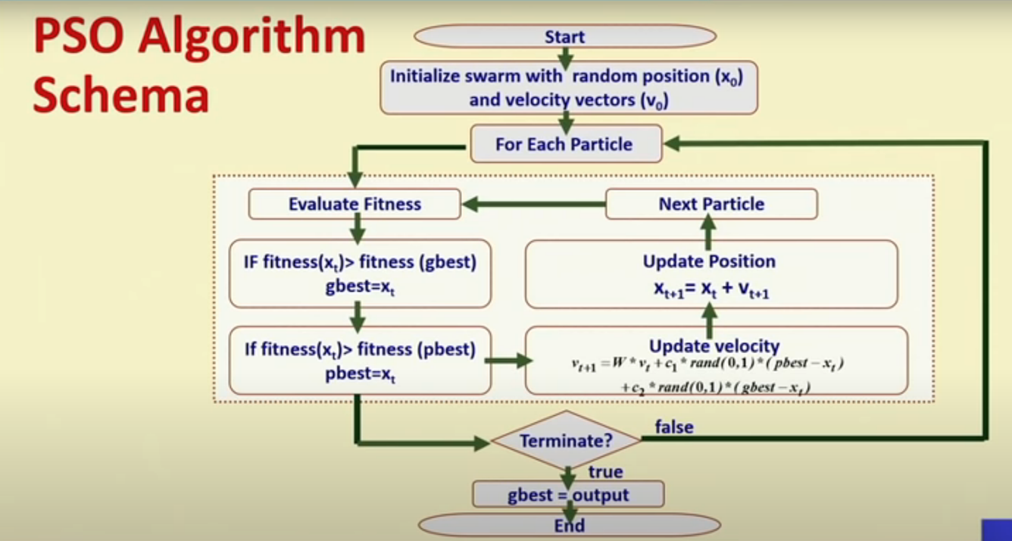

Slide 8
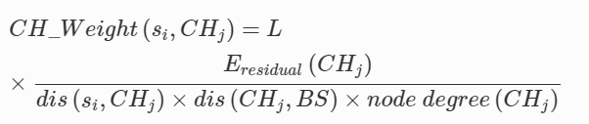
Cluster formation can be done through various parameters. Ex can be based on weight parameter where
Various routing algorithms can be used for data aggregation from CH which are to be studied in future.

Slide 9
THE END

